Slide 1
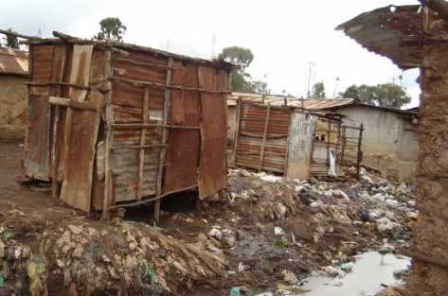
Water Sector Trust Fund
Exploring the Sanitation market: Is Sanitation a Priority?
Tenants, landlords, landladies Toilets, priorities, expectations All tables presented in this presentation are from the UBSUP Preparatory Study 2,088 households were interviewed in 11 cities and towns (Embu, Garissa, Isiolo, Kiserian, Kisii, Kisumu, Malindi/Watamu, Mombasa, Mumias, Nakuru, Ngong)

Slide 2
Main problems related to sanitation
Household members face a wide variety of sanitation problems
Below are the main problem categories and percentages
Main sanitation problem | Responses
 | Frequency | Percent
There are no toilets | 69 | 2,5
Toilets are not sufficient | 441 | 15,9
Toilets are dirty | 257 | 9,3
Toilets are dangerous (poor technical condition) | 272 | 9,8
Toilet pits are full | 110 | 4,0
Not well maintained | 244 | 8,8
Toilet smells | 369 | 13,3
Toilet overflows | 102 | 3,7
No hand-washing facility | 53 | 1,9
High water table | 130 | 4,7
Sandy soils and collapsing pits | 122 | 4,4
Flies and/or termites | 53 | 1,9
Sharing | 208 | 7,5
No problem | 82 | 3,0

Slide 3
Need to improve sanitation?
A large majority of landlords, tenants and house owners (plots occupied
by a single household) think that their sanitation situation needs improving
Type of resident | The toilet needs improving (Yes) (%)
Tenant | 77.1
Landlord | 74.0
Free lodging resident | 78.6
House owner | 72.6
Other | 79.5
Average: | 76.0

Slide 4
UBSUP Sanitation Marketing: Concept development
Approximately 86% of all households using a traditional pit latrine think this toilet facility needs to be improved
Type of toilet used by household | Toilet needs improving (Yes) (%) | Used by (%)
Traditional pit latrine | 86.2 | 53
Improved pit latrine | 69.1 | 23
Ventilated improved pit latrine (VIP) | 68.5 | 6
Pour flush toilet | 57.3 | 12
Toilet linked to a septic tank | 54.5 | 6
Toilet linked to the sewer | 87.5
Total: | 76.0 | 100

Slide 5
Investing in Sanitation
When discussing investment in sanitation, a majority of households that do have investment plans intend to rehabilitate their existing toilet
Sanitation investment plans | Frequency | Percent
Ensure toilet remains clean | 15 | 6,7
Rehabilitate existing toilet | 126 | 56,0
Build new toilet | 77 | 34,2
Don't know | 2 | ,9
Other | 3 | 1,3
Non applicable | 2 | ,9
Total | 225 | 100,0

Slide 6
Type of toilet households intend to construct
Respondents were asked if they had plans to construct a new toilet…. and if they had such plans they were asked which type of toilet they intend to construct
Type of toilet household intent to construct |  | Frequency | Percent
 | Flush toilet | 9 | 7,7
 | Traditional pit latrine | 29 | 24,8
 | Improved pit latrine | 36 | 30,8
 | Ventilated improved pit latrine | 15 | 12,8
 | Septic tank/soakaway | 4 | 3,4
 | Don't know yet | 11 | 9,4
 | Other | 7 | 6,0
 | Total | 111 | 94,9
Missing |  | 6 | 5,1
Total |  | 117 | 100,0

Slide 7
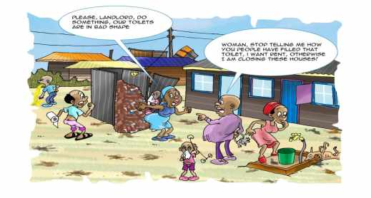
What do tenants think of their landlords and landladies?
Are landlords/-ladies able & willing to invest in better sanitation (Only the views of tenants are considered) | Frequency | Percent
Able and willing | 234 | 32,3
Able but not willing | 280 | 38,6
Willing but not able | 149 | 20,6
Not able and not willing | 33 | 4,6
Other | 15 | 2,1
Non applicable | 14 | 1,9
Total | 725 | 100,0

Slide 8
Building new toilets – Expected problems
Toilets have to be constructed or assembled
It is, therefore, important to know what problems one can expect during the construction/assembly phase
Technical problems during construction | Responses |  |  | Percent of cases
 | Frequency | Percent |  | Percent
Rocky soils | 227 | 17,7 |  | 20,4
Sandy soils | 301 | 23,4 |  | 27,0
High water table | 307 | 23,9 |  | 27,5
Space for the toilet | 139 | 10,8 |  | 12,5
Space to work | 64 | 5,0 |  | 5,7
No problem | 177 | 13,8 |  | 15,9
Other | 70 | 5,4 |  | 6,3
Total | 1.285 | 100,0 | 115,2

Slide 9
Is sanitation a household priority?
Household priorities | Frequency | Percent
Having a TV | 17 | 1,5
Safe water | 324 | 28,6
Access to a good school | 102 | 9,0
Improved sanitation | 586 | 51,7
Access to a clinic or hospital | 91 | 8,0
Don't know/No opinion | 14 | 1,2
Total | 1.134 | 100,0

Slide 10
Preferred toilets
Preferred toilet or practice: | Frequency | Percent
Traditional pit latrine | 38 | 3,4
Toilet bag ("PeePoo") | 5 | ,4
Improved pit latrine | 165 | 14,6
Ventilated improved pit latrine | 237 | 20,9
Pour flush toilet | 163 | 14,4
Urine diversion toilet | 2 | ,2
Flush toilet | 507 | 44,7
Biogas latrine | 2 | ,2
Composting toilet | 1 | ,1
Other | 14 | 1,2
Total | 1.134 | 100,0

Slide 11
What do people expect from their (new) toilet?
    Households were asked why they prefer a specific type of toilet
Why toilet type is preferred? (*) | Responses |  | Percent of Cases
 | Frequency | Percent
Modern/good/stylish | 241 | 10,0% | 21,3%
Easy to clean | 454 | 18,9% | 40,1%
Affordable | 36 | 1,5% | 3,2%
No smell | 206 | 8,6% | 18,2%
No flies | 40 | 1,7% | 3,5%
User friendly | 348 | 14,5% | 30,7%
Easy to maintain | 319 | 13,3% | 28,2%
Durable | 169 | 7,0% | 14,9%
Does not get full quickly | 29 | 1,2% | 2,6%
Safe | 57 | 2,4% | 5,0%
Can be used as a bathroom | 25 | 1,0% | 2,2%
It's common | 43 | 1,8% | 3,8%
Comfortable | 128 | 5,3% | 11,3%
Cleanliness/hygiene | 234 | 9,7% | 20,7%
Respondents were allowed to give more than one answer! (% > 100)

Slide 12
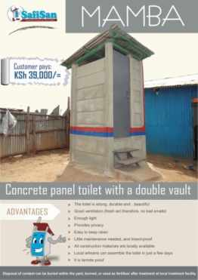
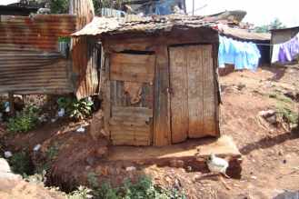
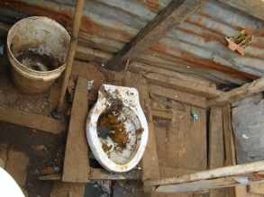
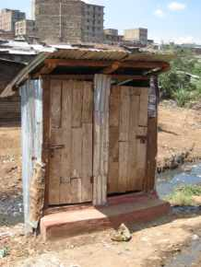
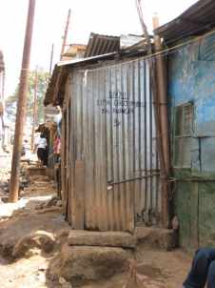


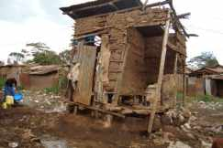





Thank You!

